Slide 1
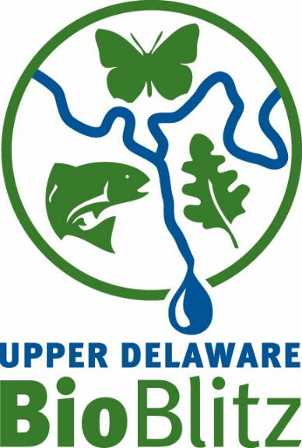
Upper Delaware BioBlitz
Why do we do it and what we’ve found
Steven Schwartz, Conservation Consultant
Don Hamilton, National Park Service (retired)
2024 Upper Delaware River Rendezvous October 16, 2024

Slide 3
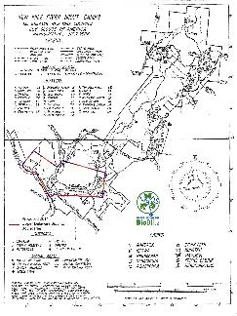
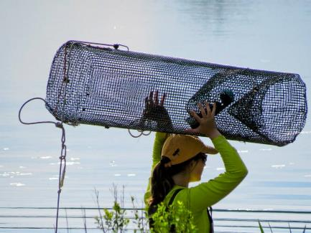
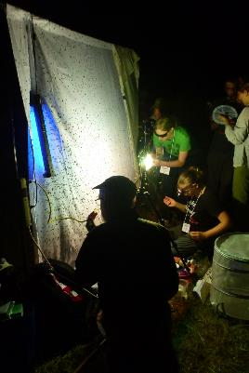
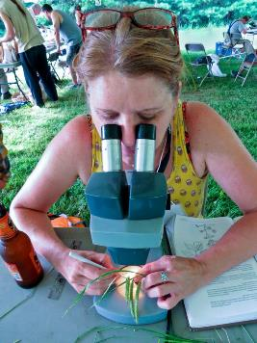
What is a Bioblitz, anyway?
A bioblitz is an event that focuses on finding and identifying as many species* as possible in a specific area over a short period of time, usually 24 hours.
*Life forms are not always keyed out to species, but to the lowest taxonomic level possible.
Notes:
It’s a short-term, intense survey of the biological diversity (biodiversity) in a specific area, where participants work together to identify as many taxa as possible:

Slide 4
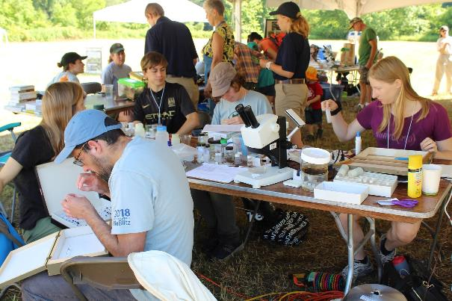
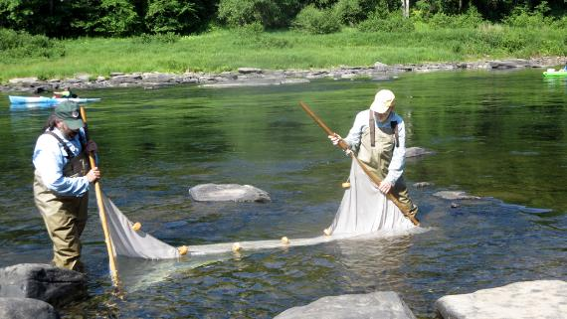
What is a Bioblitz, anyway?
Participants include scientists, naturalists, and volunteers who work together to find and identify plants, animals, and fungi.

Slide 5
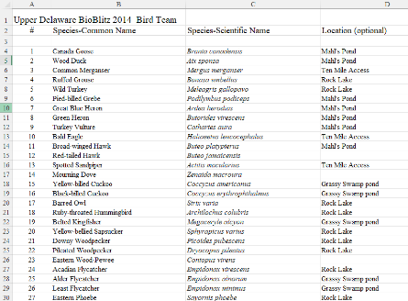
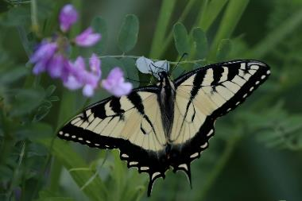
Why do Bioblitzes Matter?
Bioblitzes are an important opportunity to identify, document, and highlight the biodiversity of a location at a point in time.
Notes:
This snapshot of biodiversity provides baseline data that can be compared to future survey or inventory efforts, identifying declines in species and gauging the overall health of an ecosystem.
remarkable, beautiful tapestry of life

Slide 6
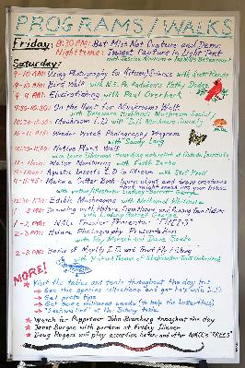
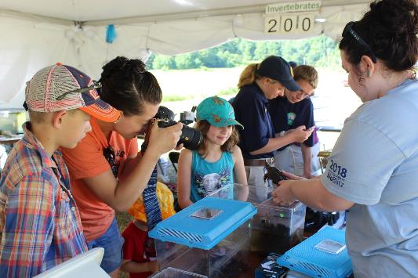
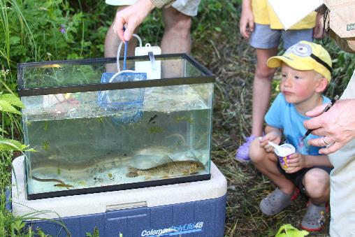
Why do Bioblitzes Matter?
Besides the scientific value, bioblitzes provide an important opportunity to engage the public in such events, helping to develop awareness, understanding, and appreciation for this biodiversity, and support for its protection.
Notes:
remarkable, beautiful tapestry of life

Slide 7
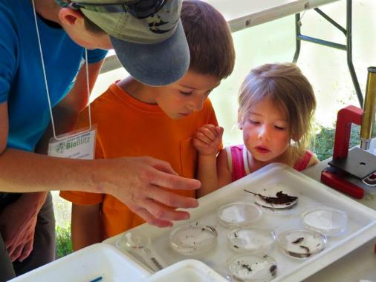
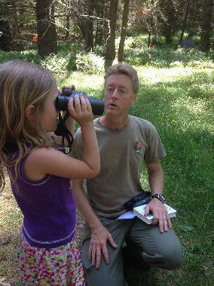
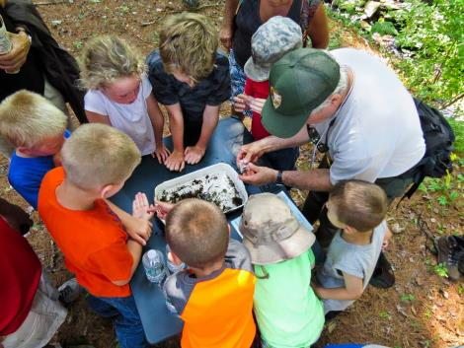
Why do Bioblitzes Matter?
There has never been a more important time to connect with and create the next generation of nature lovers, supporters, and advocates.
Notes:
remarkable, beautiful tapestry of life

Slide 8
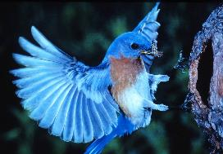
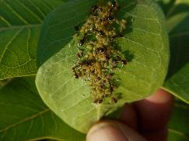
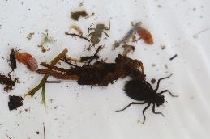
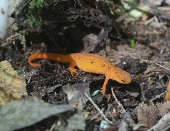
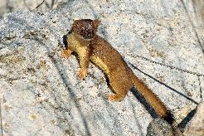
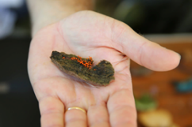
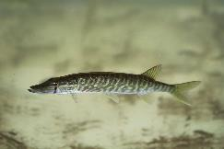
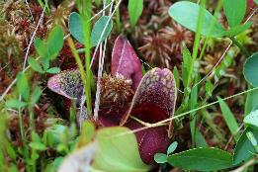
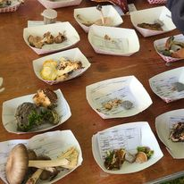
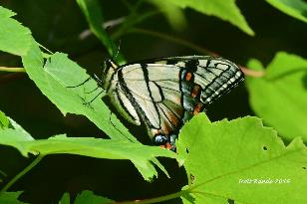
Why is Biodiversity Important?
Biodiversity refers to the variety of life on earth, covering the spectrum of unique species, genetic variation, and distinct ecosystems that support these species.
Each organism in an ecosystem plays an important role.
Ecosystems are most efficient, productive, and healthy when the biodiversity in them is high.
Notes:
Sadly, biodiversity worldwide is declining faster than ever before due to array of human-driven stressors, making it more important than ever to study and manage species decline, and to document and better understand overall species diversity and function.
Biodiversity is the key to the maintenance of the earth as we know it, dividing labor and running the natural world with efficiency and precision, the way we would want it to be run.
Diverse communities of living organisms become established in localities over time and act to efficiently enrich the soil, cycle nutrients, purify water, pollinate plants (including our crops), and create the very air we breathe, all ecosystem services that benefit and sustain us, which we could not easily or inexpensively re-engineer.
There is widespread scientific consensus that the planet is facing a crisis of biodiversity loss, with dangerous implications for humanity.

Slide 9
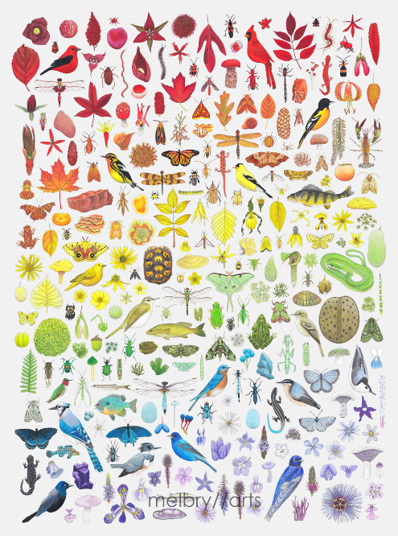
Biodiversity is Key!
“Biodiversity is the key to the maintenance of the earth as we know it, dividing labor and running the natural world with efficiency and precision, the way we would want it to be run.” ~ E.O. Wilson
Sadly, biodiversity worldwide is declining faster than ever before due to array of human-driven stressors, making it more important than ever to study and manage species decline, and to document and better understand overall species diversity and function.
Notes:
Sadly, biodiversity worldwide is declining faster than ever before due to array of human-driven stressors, making it more important than ever to study and manage species decline, and to document and better understand overall species diversity and function.
Biodiversity is the key to the maintenance of the earth as we know it, dividing labor and running the natural world with efficiency and precision, the way we would want it to be run.
Diverse communities of living organisms become established in localities over time and act to efficiently enrich the soil, cycle nutrients, purify water, pollinate plants (including our crops), and create the very air we breathe, all ecosystem services that benefit and sustain us, which we could not easily or inexpensively re-engineer.
There is widespread scientific consensus that the planet is facing a crisis of biodiversity loss, with dangerous implications for humanity.

Slide 10
2024 Site – Highlights Foundation Retreat Center, Boyds Mills, Wayne County, PA
8 teams with 40 scientists and amateur naturalists
Surveyed 250 acres of a 1,300 acre private property on the South Branch of Calkins Creek in 24 hours
Mixed open meadows and forested areas
Uplands and lowlands
Deciduous and coniferous forest stands
Wetlands, flowing creeks, manmade and beaver impoundments
Great public accessibility and infrastructure
Owned by a collaborative partner, The Highlights Foundation

Slide 12
The Almost Final Results – 2024 Upper Delaware BioBlitz
Team | Totals
Bryology/Lichenology | 64
Diatoms eDNA | 13
Fungi | 51
Botany | 170
Invertebrates | 352
Herps | 15
Birds | 67
Fish | 12
Mammals | 17
Total | 761

Slide 13
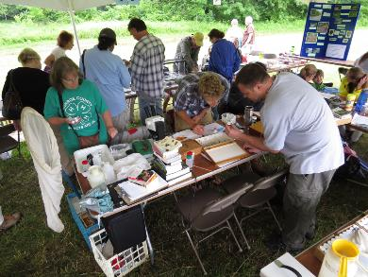
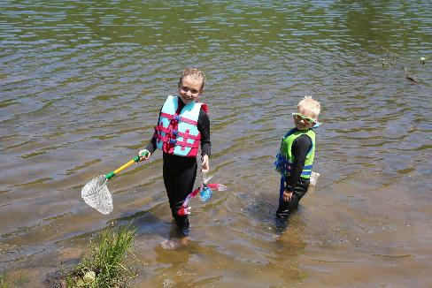
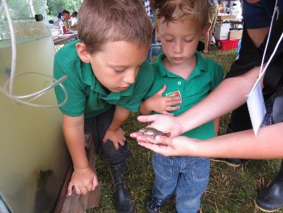
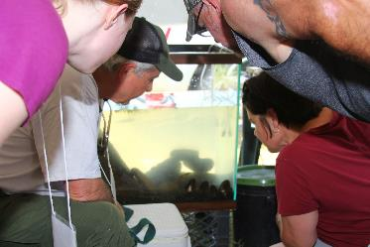

Slide 14
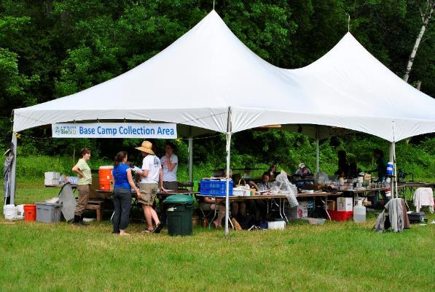
Findings Highlights
Mark Sabaj, Fish team leader, thought it was odd that the eDNA picked up American eel but he didn’t see any. They were using a seine net and not a backpack electroshocker. Eels like to hide towards the bottom of the stream and usually won’t pop up unless they get shocked. So it was good that we used eDNA which confirmed that they were there.
Diatoms were recorded for the first time at the BioBlitz thanks to the use of eDNA. Without this, we would not have been able to generate a species list.
Bryology has given us a lot of first occurrences at past events indicating the lack of field research in the region. However, a new comprehensive moss survey was conducted at Lacawac in the last couple of years, citing past BioBlitz results and it covered all of the moss species found this year.
Moth Night gave us insight into the terrestrial diversity. Setting up near the streams also gave us insight into the aquatic macro diversity on those moth sheets. While we look for counts of species and not quantity of species, it was apparent that Highlights has a spongy moth infestation, something we were able to observe at the moth lights – SO MANY SPONGY MOTHS! It was a bit disconcerting. The strong 2024 Moth Night team reported 34 first occurrences for Wayne County!

Slide 15
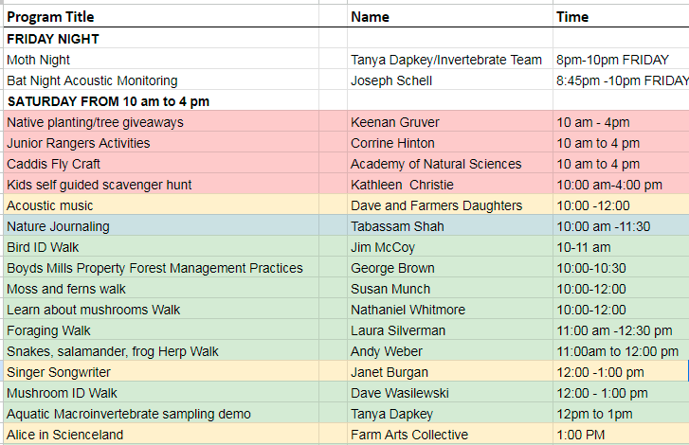
Art, Music, Theater and Activities for Kids

Slide 17
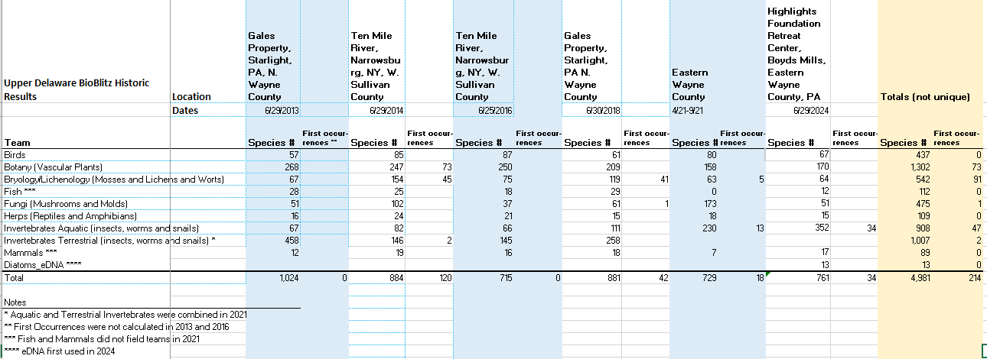
BioBlitz findings from 6 events over 11 years

Slide 18
eDNA
Environmental DNA or eDNA is DNA that is collected from a variety of environmental samples such as soil, water, snow or air, rather than directly sampled from an individual organism. As various organisms interact with the environment, DNA is expelled and accumulates in their surroundings from various sources. Such eDNA can be sequenced by environmental genomics to reveal facts about the species that are present in an ecosystem — even microscopic ones not otherwise apparent or detectable.
We had enough funding this year to do a little eDNA analysis at the BioBlitz for the first time for invertebrates, fish and diatoms
NPS and NYSDEC have conducted Northern Snakehead eDNA research in the Upper Delaware to document the extent of its range.

Slide 19
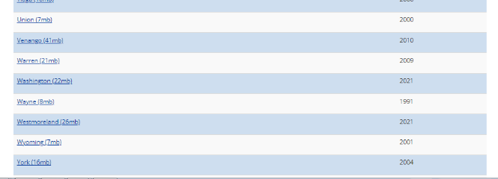
Wayne County NHAI
Every County in PA has a Natural Heritage Area Inventory. The data gathered becomes the basis for PNDI reports which are used in permitting decisions. Wayne County’s NHAI is the oldest in the state. The BioBlitz has helped build a case for updating the County’s NHAI.

Slide 20
Summary
2-300 people, including families and at least 50 kids, visited the BioBlitz in 2024
60 people participated as volunteers, active scientists, amateur naturalists and presenters
Mix of arts, entertainment and science
Moth part of the Invertebrates Team reported 34 Wayne County first occurrences
Results will continue to be updated as the scientists confirm their findings and numbers of species, especially for the Invertebrates team as full eDNA results are not yet in hand
All data will be published on the BioBlitz website
Next BioBlitz will be in 2026 and we will be looking for a new site so if you have any nominations, especially on the NY side of the river send them along
The Highlights Foundation plans to do a mini-BioBlitz in 2025 as part of the their curriculum for science writers, illustrators, editors and publishers of young people’s literature in collaboration with the Academy of Natural Sciences in Philadelphia

Slide 21
Thanks to our donors and sponsors, volunteers and team members!
Photographs by Dave Soete, Scott Rando, Sandy Long and others

Slide 22
Web, social media and email www.upperdelawarebioblitz.com www.facebook.com/UpperDelawareBioBlitz www.instagram.com/upperdelawarebioblitz info@delawarevalleyramps.com
Thank You!

